Slide 1
Mokomės daugybos lentelę

Slide 2
Kurią daugybos lentelę mokinsimės?

Slide 3
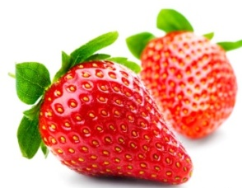
12
6
2 ⋅ 6
2 ⋅ 3
16
2 ⋅ 8
4
2 ⋅ 2
10
14
2 ⋅ 5
2 ⋅ 7
18
8
2 ⋅ 9
2 ⋅ 4
IŠEITI
ATGAL

Slide 4
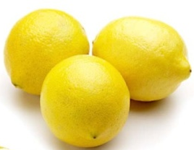
8
27
3 ⋅ 2
3 ⋅ 9
18
21
3 ⋅ 6
3 ⋅ 7
9
24
3 ⋅ 3
3 ⋅ 8
15
12
3 ⋅ 5
3 ⋅ 4
IŠEITI
ATGAL

Slide 5
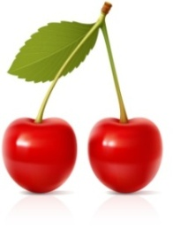
28
20
4 ⋅ 7
4 ⋅ 5
32
16
4 ⋅ 8
4 ⋅ 4
24
8
4 ⋅ 6
4 ⋅ 2
36
12
4 ⋅ 9
4 ⋅ 3
IŠEITI
ATGAL

Slide 6
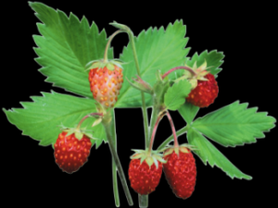
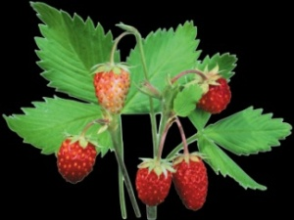
40
20
5 ⋅ 8
5 ⋅ 4
35
10
5 ⋅ 7
5 ⋅ 2
25
45
5 ⋅ 5
5 ⋅ 9
30
15
5 ⋅ 6
5 ⋅ 3
IŠEITI
ATGAL

Slide 7
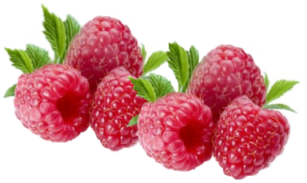
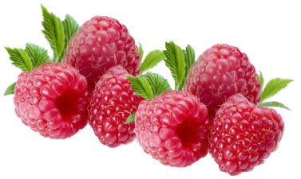
12
6 ⋅ 2
30
6 ⋅ 5
36
54
6 ⋅ 6
6 ⋅ 9
48
18
6 ⋅ 8
6 ⋅ 3
42
24
6 ⋅ 7
6 ⋅ 4
IŠEITI
ATGAL

Slide 8
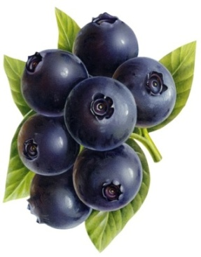
49
21
7 ⋅ 7
7 ⋅ 3
56
35
7 ⋅ 8
7 ⋅ 5
14
63
7 ⋅ 2
7 ⋅ 9
28
42
7 ⋅ 4
7 ⋅ 6
IŠEITI
ATGAL

Slide 9
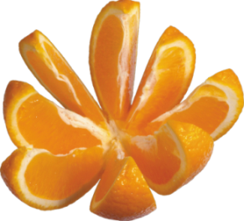
40
64
8 ⋅ 5
8 ⋅ 8
32
24
8 ⋅ 4
8 ⋅ 3
72
16
8 ⋅ 9
8 ⋅ 2
56
48
8 ⋅ 7
8 ⋅ 6
IŠEITI
ATGAL

Slide 10
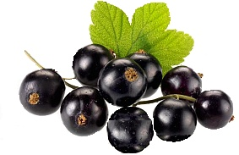
81
27
9 ⋅ 9
9 ⋅ 3
72
36
9 ⋅ 8
9 ⋅ 4
45
18
9 ⋅ 5
9 ⋅ 2
54
63
9 ⋅ 6
9 ⋅ 7
IŠEITI
ATGAL

Slide 11
PABAIGA

